Slide 1


Magic Eyewear Virtual Try-On Software
Team Members
Farida Hesham, Ragaa Moustafa, Samiha Hussien, and Yara Amr

Slide 2


Agenda
Introduction
Problem Statement
System Overview
PACT Analysis
HTA
Use Case Diagram
Functional Requirements
Non-Functional Requirements
Database
Class Diagram
Survey Results
Prototype

Slide 3
Introduction

Slide 4
Obtaining eyewear online is an issue that faces many people who wear glasses.
Going to the store has increasingly become a hassle, especially during a pandemic like COVID-19.
Multiple optics stores -outside of Egypt- have started to acquire virtual smart mirrors on their website to facilitate the purchase process.
There are no Egypt-based stores that have implemented such software.
The idea of Magic Eyewear was presented to the team by the manager of EyeCare Optics -an Egyptian startup optics company.
Magic Eyewear is a virtual smart mirror (virtual try-on software) implementation that allows customers to virtually view glasses on themselves.
It shall be the first Egypt-based virtual eyewear try-on software.
Goals:
Tackle the issue of requiring to visit a physical store to find suitable glasses
Deliver more accessible eyewear shopping

Slide 5
Problem Statement

Slide 6
Problem Statement
Visiting an on-ground store has become a hassle
Online shopping for eyewear is risky
Product pictures may not match the customer's expectations upon delivery
Project Goals:
Make the online shopping experience easier and more guaranteed
Make frames more accessible

Slide 7
System Overview

Slide 8
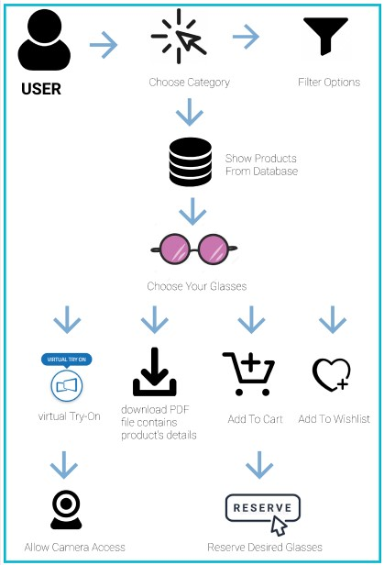
System Overview

Slide 9
PACT Analysis

Slide 10

PACT Analysis
People
Computer Knowledge
Cognitive Differences
Physical Differences
Context
Physical
Technology
Input
Output
Content
Communications
Activities
Browse
Filter Options
Virtual Try-on
Download PDF File
Reserve / Add to Cart

Slide 11
Hierarchal Task Analysis (HTA)

Slide 12
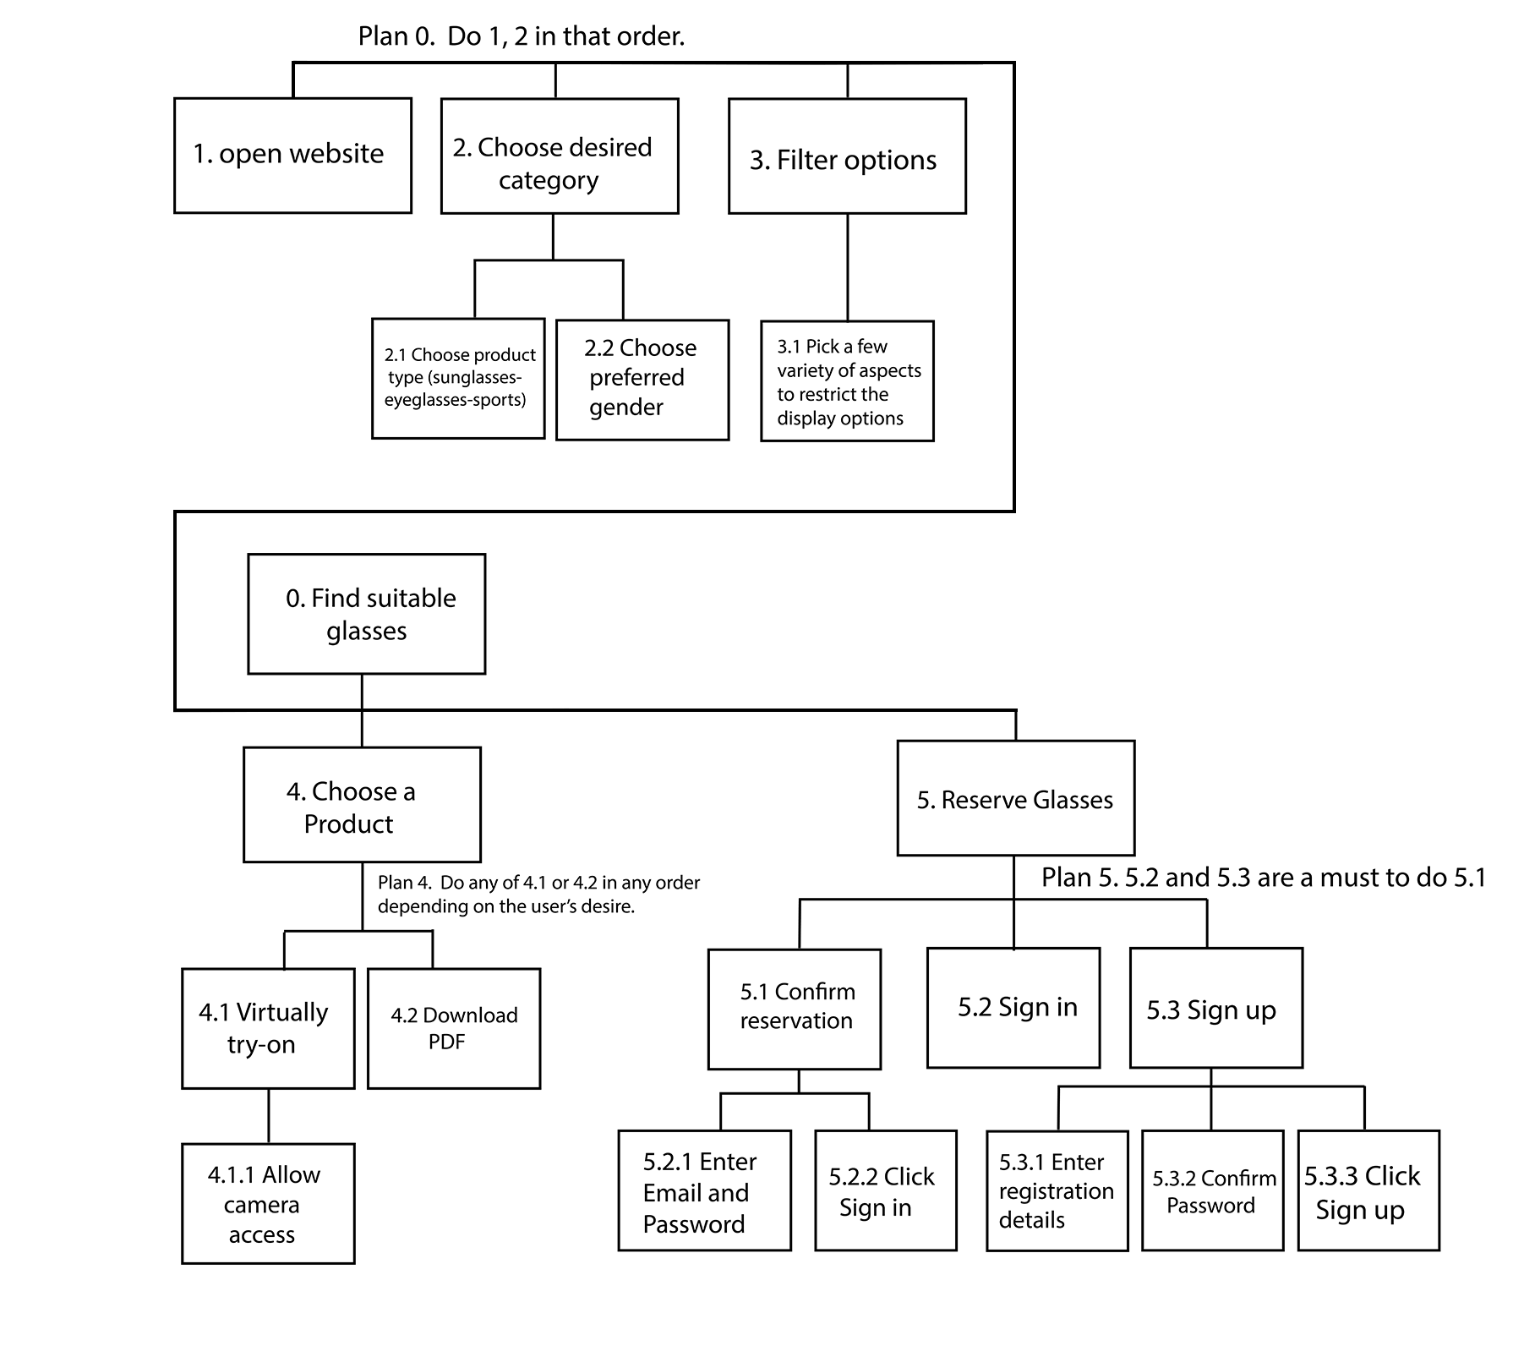
HTA

Slide 13
Use Case Diagram

Slide 14
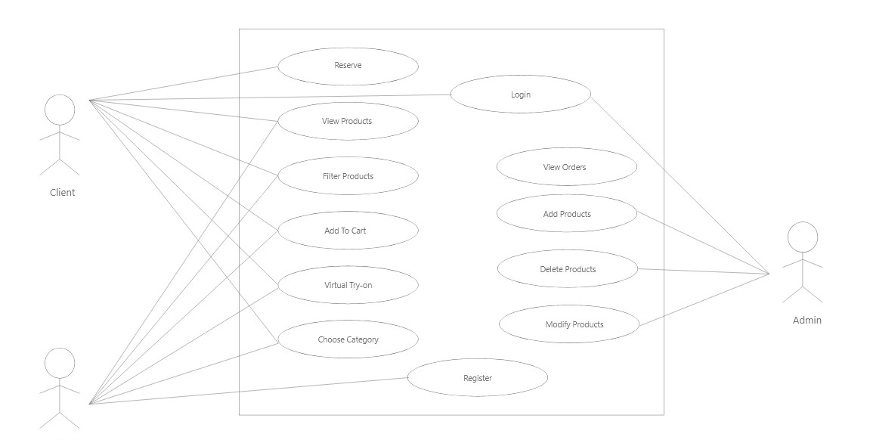
Use Case Diagram

Slide 15
Functional Requirements

Slide 16
Top 3 Functional Requirements
User can virtually try on any frame of their choice.
User can reserve frames to pick up later from store.
User can enter their frame measurements (e.g.: IPD).

Slide 17
Non-Functional Requirements

Slide 18
Non-Functional Requirements
Security:
Availability:
Performance:
Usability:
Camera Access Request
Password-protected account
Available 98% of the time
2% dedicated for maintenance
Web Pages: load time <=5s
Order Reservation: <=10s
Virtual Try-on: load time <=10s
Requires minimal to moderate tech-knowledge
Requires internet connection

Slide 19
Database

Slide 20
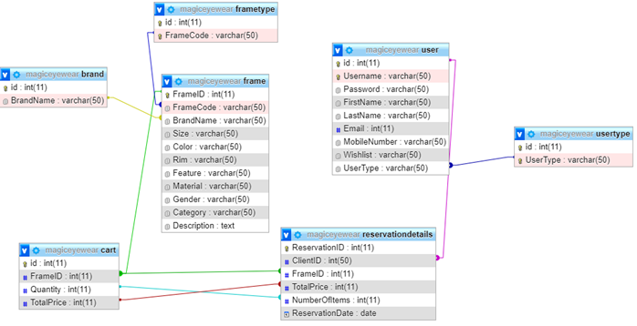
Initial Database Schema

Slide 21
Class Diagram

Slide 22
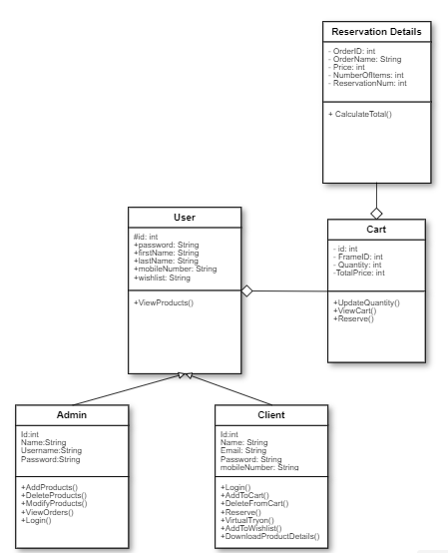
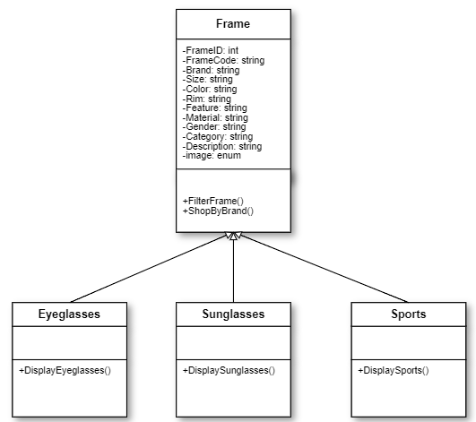
Class Diagram

Slide 23
Data Collection

Slide 24
Data Collection
Data Collection Method:
Google Form instead of user interviews
Reasons:
Higher reach
More diverse answers
Question Types:
Qualitative
Quantitative

Slide 25
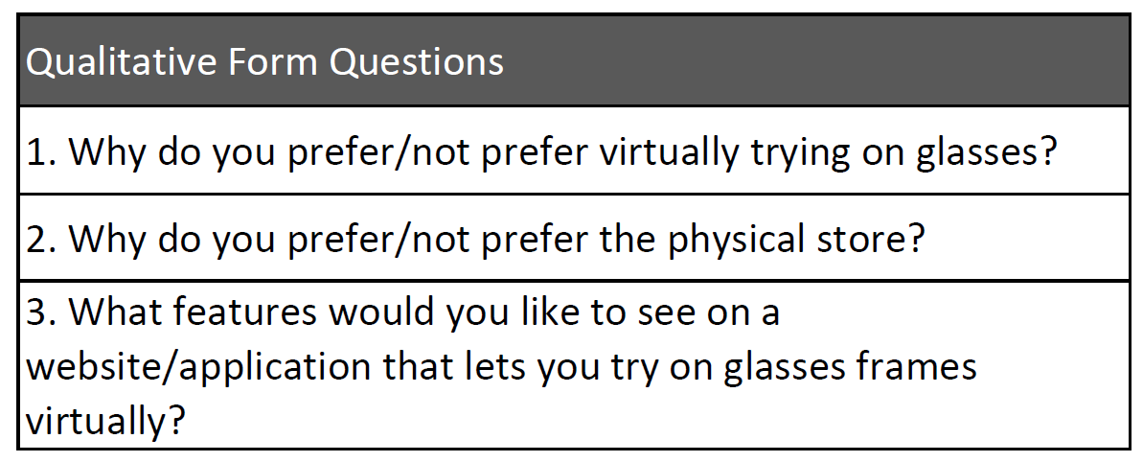
Qualitative Questions

Slide 26
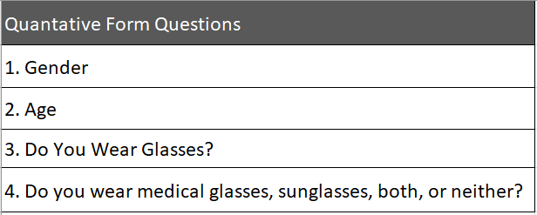
Quantitative Questions

Slide 27
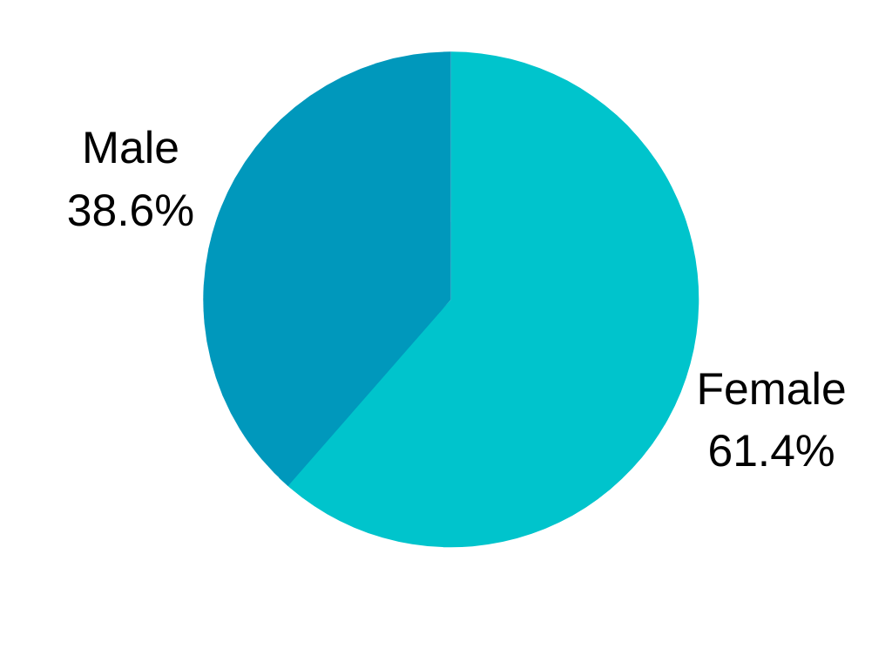
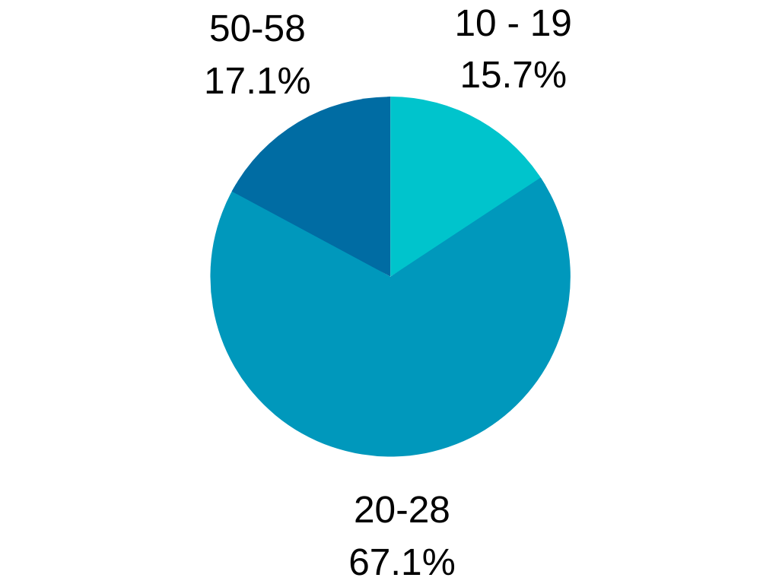
Quantitative Responses
Gender
Age

Slide 28
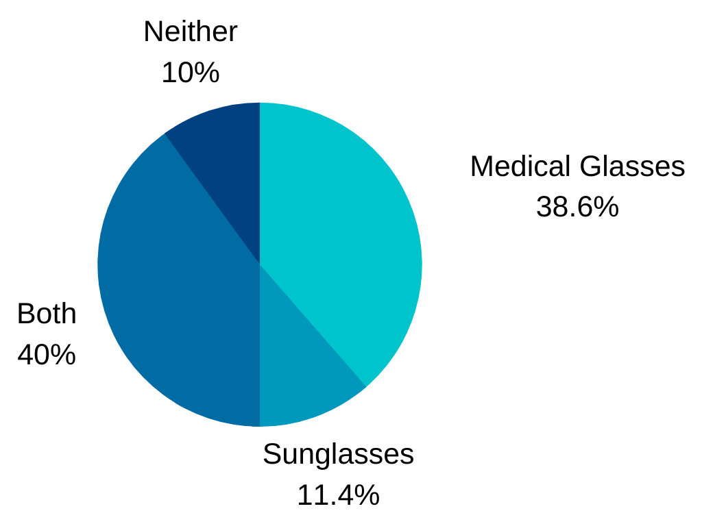
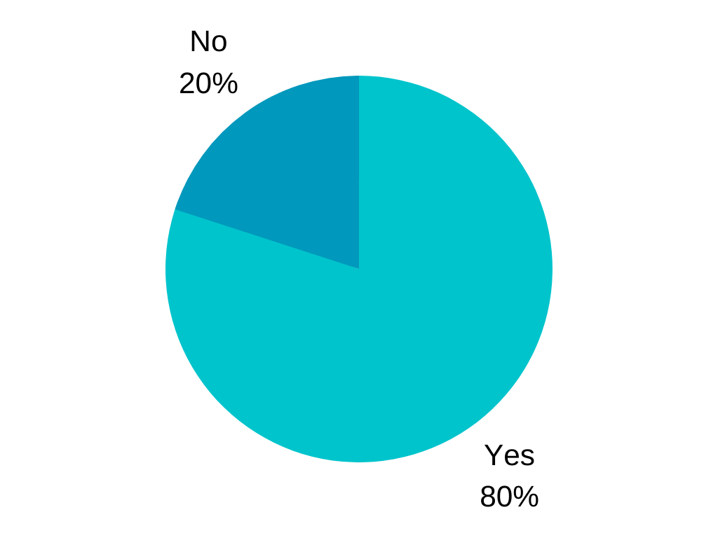
Quantitative Responses
Do you wear medical glasses, sunglasses, both, or neither?
Do you wear glasses?

Slide 29
Prototype

Slide 30
Live Demo

Slide 31
Thank You!

Slide 32


